Slide 1
EXCEL MULTI TRAINING
Date: 18-10-2021

Slide 2
Welcome
DATA
STATISTICS
Excel Multi Training
With SERVICE
Joppe van Veghel
3rd year Master USRE – CME graduation student (Brink)
Incorporating human perception in computational urban design
Chairman of SERVICE 2020-2021

Slide 3
Planning
Excel in context
Excel basics
Excel in multi
How some basic Excel skills can take your multi project to another level
Everything is relative, just make sure your excel sheet looks better then your the excel sheet of the other multi students

Slide 4
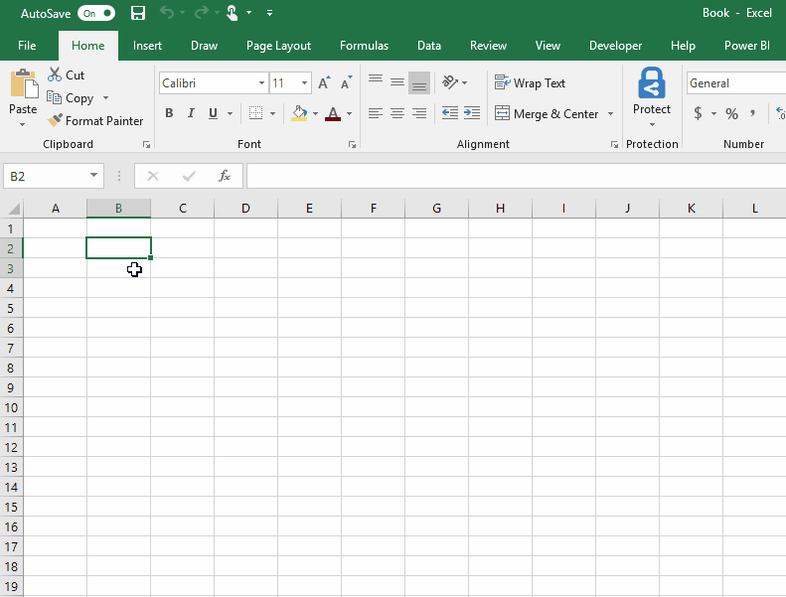
Excel in context
What is Excel?
“A spreadsheet is a software application that enables a user to save, sort and manage data in an arranged form of rows and columns.” Techopedia
“Each row and column can be manipulated with formulas, commands, and formats. This tool is can be very useful for accountants, financial analysts, and business people to analyze business performance numbers and results.” Myaccountingcourse
But also for not too advanced data analysis!

Slide 5
Excel in context Excel is DATA in a nice interface
Easy to learn!
Everything is possible, just pick the right method and ask Google for help!
Low level of automatization
Low level of customization
Less time intensive
High level of automatization
High level of customization
More time intensive

Slide 6
Excel in context
Multi
So if Excel is an interface for data management, for what can you use it?
Financial applications
Organising
Calculating
Predicting
Managing
Organising applications
Planning & Overview
Data management and manipulation
Calculations
Predictions
Minor adjustments - .CSV
Communication
Communicate data driven results
Combination!
Multi
Multi
Multi

Slide 7
Excel basics
Interface
MENU
SHORTCUTS
Datatypes
BASIC DATA TYPES AND IMPORTANT MATTERS TO TAKE INTO ACCOUNT
Data Manipulation
SELECTING AND FINDING & REPLACING
COPY AND PASTE OPTIONS
INSERTION AND EXTENSION
Table organisation
LONG AND WIDE TABLES
HEADER AND FILTER
TIPS & TRICKS
Makeup and conditional makeup
ALLIGNMENT & TEXT
BORDERS
HIDING & COMMENTS
CONDITIONAL MAKEUP
Formula’s and calculations
ALL RELEVANT FORMULAS
HOW TO GENERALLY IMPLEMENT THEM
Data analysis
FILTERING & SORTING
GOAL SEEK & SOLVER
CHARTS
st
Do you want to become a data legend?
Excel & Python Training – the basics
https://www.service-studievereniging.nl/courses-2/

Slide 8
Excel basics – General tips
The spreadsheet
Work with tabs/sheets and make them interconnected including:
Front
Result
Calculations
Visualisations (put them in the way that you want to tell the story)
Within calculations:
Hide as little as possible
Make as much as possible connected
Maintain the overview
Mark what needs to be filled in by the user
Assign the right datatype
Be explicit in the column headers
Visualise relations
Excel is doing weird? -> No Excel never does weird, you made it look weird. Together with Google you will find the problem

Slide 9
Excel Multi – basic Excel functions
Formulas
SUM
IF
Etc. -> YOU WANT SOMETHING MAGICAL? GOOGLE KNOWS IT
Relations
= B4
='Ground Value'!C65
Basic functions
$ (F4) -> $B$4
Open the multi sheet that you received
Function in the sheet
Capabilities of the sheet
Market Value
Discounted Cash Flow
Extra skills & capabilities

Slide 10
SERVICE
Lunchlecture Wednesday 20th of October
The lunch lecture by AT Osborne will be about the mobility sector in the Brainport region:
Intermediate Colloquium 21st of October
StudyTrip survey
SERVICE webpage

